Slide 1
BASE DE DADOS
BASE DE DADOS
SQL - SELECT
Teórico-Práticas

Slide 2
Conceitos base
SQL – Structured Query Language: linguagem padrão para acesso e manipulação de uma base de dados relacional
SQL é composto, no essencial, por 10 instruções base que normalmente se agrupam em três conjuntos: DDL, DML e DCL
DDL – Data Definiton Language (create, alter, drop)
DML – Data Manipulation Language (insert, update, delete, select)
DCL – Data Control Language (grant, revoke, deny)
A DML inclui quatro instruções que permitem manipular os dados:
insert - inserir registos na base de dados
update – atualizar atributos de registos
delete – remover registos
select – consultar a base de dados, selecionar dados

Slide 3
O SELECT permite extrair informação de uma Base de Dados ou seja, efetuar consultas à Base de Dados.
O resultado de uma consulta é uma relação.
Na sua forma mais básica é preciso apenas indicar a cláusula SELECT e FROM, sendo as restantes opcionais.
SELECT [ ALL | DISTINCT ] <select_list>
FROM <table_list>
[WHERE <where_expression>]
[GROUP BY <groupby_list>]
[HAVING <having_expression>]
[ORDER BY <orderby_list> [DESC|ASC]]

Slide 4
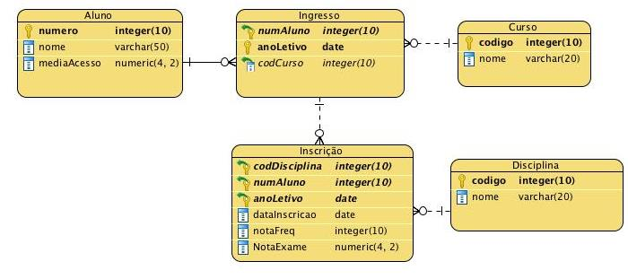
Consultas de dados numa BDR
Dado o UoD/domínio “inscrições em disciplinas” representado pelo seguinte modelo de dados relacional:
Curso(codigo, nome)
Aluno(numero, nome, mediaAcesso)
Disciplina(codigo, nome)
Ingresso(numAluno, anoLetivo, codCurso)
Inscricao(codDisciplina, numAluno, anoLetivo, dataInscricao, notaFreq, notaExame)

Slide 5
SQL permite duplicados nas relações, bem como nos resultados das consultas.
Para forçar a eliminação de duplicados, deve-se inserir a declaração DISTINCT depois do select.
A cláusula SELECT pode conter expressões aritméticas envolvendo os operadores +, - , * , / e operações em constantes ou atributos dos registos.
A cláusula SELECT também permite renomear os nomes da tabelas e os nomes dos atributos
SELECT DISTINCT < lista de atributos>
…..

Slide 6
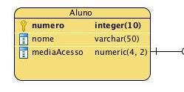
Liste as médias de acesso de todos os alunos

Slide 7
WHERE
O comando WHERE permite selecionar um sub-conjunto de registos de uma relação que satisfazem uma determinada condição sobre alguns atributos.
A condição pode conter operadores de comparação (<, >, <=, <>, ...) e pode ser composta usando AND, OR e NOT.
Permite também o uso de IS NULL ou IS NOT NULL

Slide 9
Podemos dar um nome à coluna

Slide 10
WHERE
Permite usar o operador LIKE em operações com strings.
O operador LIKE é usado para pesquisas não exatas.
Faz uso de dois caracteres especiais:
_ (substitui 1 caracter)
% (substitui qualquer sequência de caracteres)

Slide 11
ORDER BY
A resposta a uma pergunta pode ser ordenada segundo uma ou mais colunas.
Para proceder à ordenação usa-se o comando ORDER BY seguido das colunas que queremos ordenar.
Por omissão as colunas são ordenadas ascendentemente.
Podemos mudar a direção da ordenação usando as palavras ASC e DESC.

Slide 12
ORDER BY

Slide 13
FUNÇÕES DE AGREGAÇÃO
Estas funções operam nos multi-conjuntos de valores de uma coluna de uma relação e retornam um valor:
COUNT ([DISTINCT] A): O número de valores (únicos) na coluna A
SUM ([DISTINCT] A): A soma de todos os valores (únicos) de A
AVG ([DISTINCT] A): A média de todos os valores (únicos) de A
MAX (A). O valor máximo existente na coluna A
MIN (A). O valor mínimo existente na coluna A
Se um SELECT tem uma operação de agregação, então apenas pode conter colunas com operadores de agregação, excepto se tiver uma cláusula GROUP BY

Slide 14
FUNÇÕES DE AGREGAÇÃO

Slide 16
Como resolver ?

Slide 17

SELECT
How to build a SELECT query?

Slide 18
Query the database
Given the data model below:
student(id, name)
course(code, ects)
course_edition(course, edition, year, semester)
enroll(student, course, edition, grade)
Answer the following query:
Name of the students who are enrolled in the first semester of 2020 to courses summing up more than 10 ECTS credits?

Slide 19
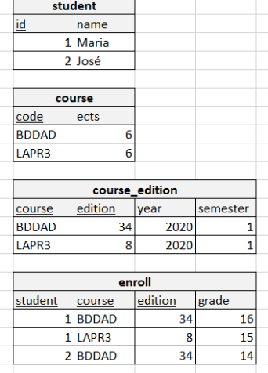
Current status of the database
STEP 1
Which tables do I need to join? Which tables have the data I need to answer the query?
student, I need the student name
course, I need to sum up the ECTS credits
course_edition, I need the year and semester
enroll, I need to know which courses the student joined

Slide 20
Current status of the database
LAST STEP
The SELECT statement
SELECT name
FROM student s, course c, course_edition ce, enroll e
WHERE s.id = e.student
AND c.code = ce.course
AND ce.course = e.course
AND ce.edition = e.edition
AND ce.year = 2020
AND ce.semester = 1
GROUP BY s.name
HAVING SUM(c.ects) > 10
ORDER BY s.name
How do I get here?
STEP 2

Slide 21
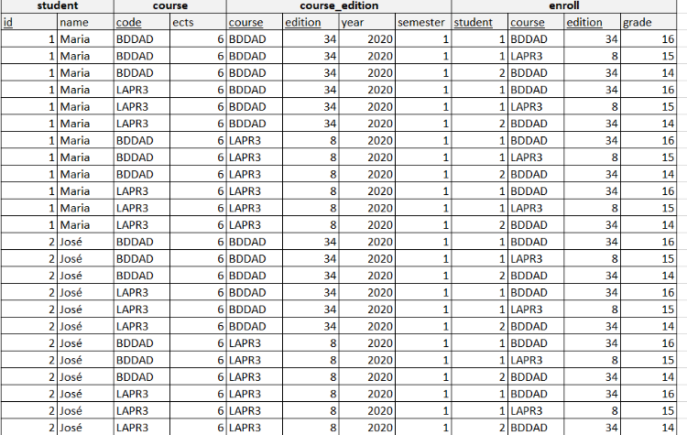
Produto cartesiano / Cartesian product (FROM)
STEP 2.1 – imagine a table made by all attributes and all possible combinations of tuples from the tables in FROM clause (cartesian product)
SELECT name
FROM student s, course c, course_edition ce, enroll e
WHERE s.id = e.student
AND c.code = ce.course
AND ce.course = e.course
AND ce.edition = e.edition
AND ce.year = 2020
AND ce.semester = 1
GROUP BY s.name
HAVING SUM(c.ects) > 10
ORDER BY s.name
Cartesian product:
ARITY= sum of the arity of all the tables in the FROM clause
CARDINALITY = product of the cardinalities of all the tables in the FROM clause

Slide 22
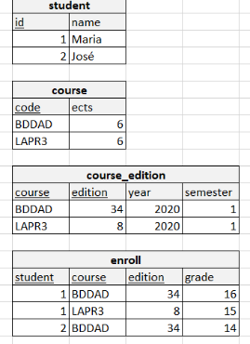
Join, natural join, selection (WHERE)
STEP 2.2 – keep only the tuples with all attributes referring to the same instance (join, natural join)
SELECT name
FROM student s, course c, course_edition ce, enroll e
WHERE s.id = e.student
AND c.code = ce.course
AND ce.course = e.course
AND ce.edition = e.edition
AND ce.year = 2020
AND ce.semester = 1
GROUP BY s.name
HAVING SUM(c.ects) > 10
ORDER BY s.name

Slide 23
Join, natural join, selection (WHERE)
STEP 2.2 – keep only the tuples with all attributes referring to the same instance (join, natural join)
SELECT name
FROM student s, course c, course_edition ce, enroll e
WHERE s.id = e.student
AND c.code = ce.course
AND ce.course = e.course
AND ce.edition = e.edition
AND ce.year = 2020
AND ce.semester = 1
GROUP BY s.name
HAVING SUM(c.ects) > 10
ORDER BY s.name

Slide 24
Join, natural join, selection (WHERE)
STEP 2.2 – keep only the tuples with all attributes referring to the same instance (join, natural join)
SELECT name
FROM student s, course c, course_edition ce, enroll e
WHERE s.id = e.student
AND c.code = ce.course
AND ce.course = e.course
AND ce.edition = e.edition
AND ce.year = 2020
AND ce.semester = 1
GROUP BY s.name
HAVING SUM(c.ects) > 10
ORDER BY s.name
Hint (join):
To avoid cartesian products, which in general are not welcome, make sure to have N-1 join criteria when joining N tables.

Slide 25
Join, natural join, selection (WHERE)
STEP 2.2 – keep only the tuples with all attributes referring to the same instance (join, natural join)
SELECT name
FROM student s, course c, course_edition ce, enroll e
WHERE s.id = e.student
AND c.code = ce.course
AND ce.course = e.course
AND ce.edition = e.edition
AND ce.year = 2020
AND ce.semester = 1
GROUP BY s.name
HAVING SUM(c.ects) > 10
ORDER BY s.name
4 tables
3 join conditions

Slide 26
Join, natural join, selection (WHERE)
STEP 2.2 – keep only the tuples with all attributes referring to the same instance (join, natural join)
SELECT name
FROM student s, course c, course_edition ce, enroll e
WHERE s.id = e.student
AND c.code = ce.course
AND ce.course = e.course
AND ce.edition = e.edition
AND ce.year = 2020
AND ce.semester = 1
GROUP BY s.name
HAVING SUM(c.ects) > 10
ORDER BY s.name
4 tables
3 join conditions

Slide 27
Join, natural join, selection (WHERE)
STEP 2.2 – keep only the tuples with all attributes referring to the same instance (join, natural join)
SELECT name
FROM student s, course c, course_edition ce, enroll e
WHERE s.id = e.student
AND c.code = ce.course
AND ce.course = e.course
AND ce.edition = e.edition
AND ce.year = 2020
AND ce.semester = 1
GROUP BY s.name
HAVING SUM(c.ects) > 10
ORDER BY s.name
4 tables
3 join conditions

Slide 28
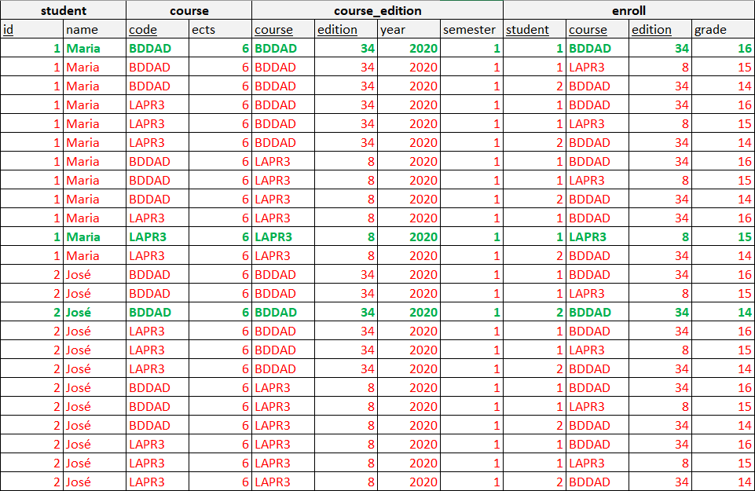
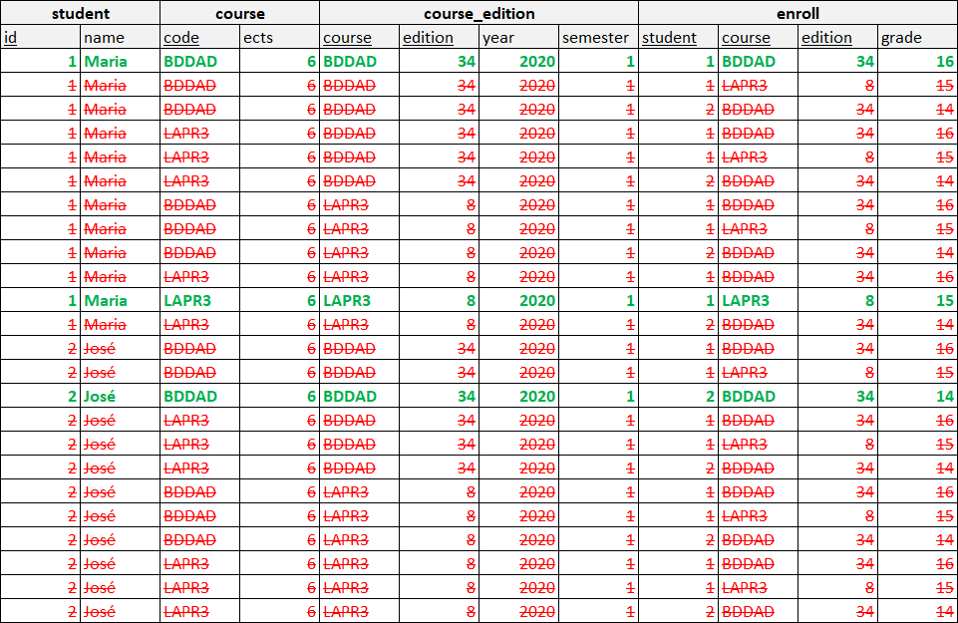
Join, natural join, selection (WHERE)
STEP 2.2 – keep only the tuples with all attributes referring to the same instance (join, natural join)
SELECT name
FROM student s, course c, course_edition ce, enroll e
WHERE s.id = e.student
AND c.code = ce.course
AND ce.course = e.course
AND ce.edition = e.edition
AND ce.year = 2020
AND ce.semester = 1
GROUP BY s.name
HAVING SUM(c.ects) > 10
ORDER BY s.name
4 tables
3 join conditions

Slide 29
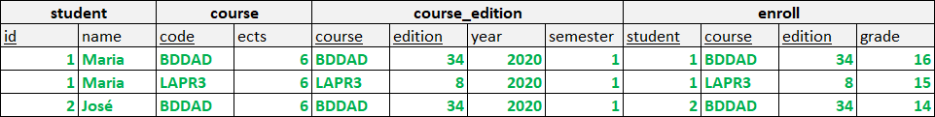
Join, natural join, selection (WHERE)
STEP 2.2 – keep only the tuples with all attributes referring to the same instance (join, natural join)
SELECT name
FROM student s, course c, course_edition ce, enroll e
WHERE s.id = e.student
AND c.code = ce.course
AND ce.course = e.course
AND ce.edition = e.edition
AND ce.year = 2020
AND ce.semester = 1
GROUP BY s.name
HAVING SUM(c.ects) > 10
ORDER BY s.name

Slide 30
Join, natural join, selection (WHERE)
STEP 2.2 – keep only the tuples with all attributes referring to the same instance (join, natural join)
SELECT name
FROM student s, course c, course_edition ce, enroll e
WHERE s.id = e.student
AND c.code = ce.course
AND ce.course = e.course
AND ce.edition = e.edition
AND ce.year = 2020
AND ce.semester = 1
GROUP BY s.name
HAVING SUM(c.ects) > 10
ORDER BY s.name

Slide 31
Query criteria, selection (WHERE)
STEP 2.3 – filter out the tuples not matching the criteria of relevance (selection)
SELECT name
FROM student s, course c, course_edition ce, enroll e
WHERE s.id = e.student
AND c.code = ce.course
AND ce.course = e.course
AND ce.edition = e.edition
AND ce.year = 2020
AND ce.semester = 1
GROUP BY s.name
HAVING SUM(c.ects) > 10
ORDER BY s.name

Slide 32
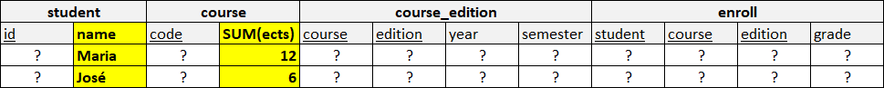
Aggregation, clustering, grouping (GROUP BY)
STEP 2.4 – aggregate tuples by the attributes in GROUP BY clause (aggregation)
SELECT name
FROM student s, course c, course_edition ce, enroll e
WHERE s.id = e.student
AND c.code = ce.course
AND ce.course = e.course
AND ce.edition = e.edition
AND ce.year = 2020
AND ce.semester = 1
GROUP BY s.name
HAVING SUM(c.ects) > 10
ORDER BY s.name
Hint (GROUP BY):
To prevent ambiguity, when a SELECT statement has a GROUP BY clause, all its projected attributes (SELECT clause) must be either aggregate functions or named in the GROUP BY clause

Slide 33
Aggregation, clustering, grouping (GROUP BY)
STEP 2.4 – aggregate tuples by the attributes in GROUP BY clause (aggregation)
SELECT name
FROM student s, course c, course_edition ce, enroll e
WHERE s.id = e.student
AND c.code = ce.course
AND ce.course = e.course
AND ce.edition = e.edition
AND ce.year = 2020
AND ce.semester = 1
GROUP BY s.name
HAVING SUM(c.ects) > 10
ORDER BY s.name

Slide 34
Aggregation, clustering, grouping (GROUP BY)
STEP 2.4 – aggregate tuples by the attributes in GROUP BY clause (aggregation)
SELECT name
FROM student s, course c, course_edition ce, enroll e
WHERE s.id = e.student
AND c.code = ce.course
AND ce.course = e.course
AND ce.edition = e.edition
AND ce.year = 2020
AND ce.semester = 1
GROUP BY s.name
HAVING SUM(c.ects) > 10
ORDER BY s.name
Hint (HAVING):
HAVING exists only in a GROUP BY; if we have no GROUP BY clause we cannot have the HAVING clause.
The HAVING clause sets selection criteria for each group generated by the GROUP BY
The WHERE clause sets selection criteria for each tuple before grouping

Slide 35
Aggregation, clustering, grouping (GROUP BY)
STEP 2.5 – sort the results set according to the ORDER BY clause (sorting the output result set)
SELECT name
FROM student s, course c, course_edition ce, enroll e
WHERE s.id = e.student
AND c.code = ce.course
AND ce.course = e.course
AND ce.edition = e.edition
AND ce.year = 2020
AND ce.semester = 1
GROUP BY s.name
HAVING SUM(c.ects) > 10
ORDER BY s.name

Slide 36
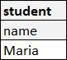
Projection, settle result set attributes (SELECT fields)
STEP 2.6 – specify the structure of the output/result set (attributes, constants, expressions in the SELECT clause)
SELECT name
FROM student s, course c, course_edition ce, enroll e
WHERE s.id = e.student
AND c.code = ce.course
AND ce.course = e.course
AND ce.edition = e.edition
AND ce.year = 2020
AND ce.semester = 1
GROUP BY s.name
HAVING SUM(c.ects) > 10
ORDER BY s.name

Slide 37
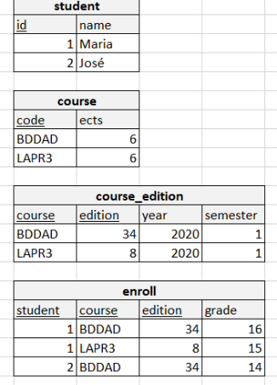
Name of the students who are enrolled in the first semester of 2020 to courses summing up more than 10 ECTS credits?
SELECT name
FROM student s, course c, course_edition ce, enroll e
WHERE s.id = e.student
AND c.code = ce.course
AND ce.course = e.course
AND ce.edition = e.edition
AND ce.year = 2020
AND ce.semester = 1
GROUP BY s.name
HAVING SUM(c.ects) > 10
ORDER BY s.name

